Slide 1
Brain Tumor
Classification
Presented by:
Mohamed Deeb & Noura Medhat
Supervised by : Dr.Shady Nagy
Facilitator: Eng. Ali Hamed

Slide 2
AGENDA
Introduction
Problem Statement & Business solution
Dataset Description & EDA
CNN models
Project Deployment

Slide 3

Introduction
3

Slide 4
A brain tumor is a mass or growth of abnormal cells in your brain. How quickly a brain tumor grows can vary greatly. The growth rate as well as the location of a brain tumor determines how it will affect the function of your nervous system.
Types of brain tumors:
Meningiomas. A meningioma is a tumor that arises from the membranes that surround your brain and spinal cord (meninges). Most meningiomas are noncancerous.
Pituitary adenomas. These are tumors that develop in the pituitary gland at the base of the brain. These tumors can affect the pituitary hormones with effects throughout the body.
Gliomas. These tumors begin in the brain or spinal cord and include astrocytomas, ependymomas, glioblastomas, oligoastrocytomas and oligodendrogliomas.

Slide 5
Problem Statement & Business solution
3

Slide 6
Problem Statement
Brain tumors are among the most serious tumors, and a significant number of people lose their lives each year as a result of incorrect diagnoses.
Therefore, being able to offer a remedy or create a sophisticated CNN model that could make this diagnosis will undoubtedly reduce the death rate and be useful throughout the healing process.
Business Solution

Slide 7
Dataset Description & EDA
5

Slide 8
Dataset Description
The dataset mainly is split into 2 directories:
1- Train dataset
2- Test dataset
Each directory has 4 directories:
1- No tumor
2- Meningiomas
3- Pituitary
4- Glioma

Slide 9
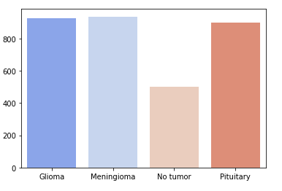
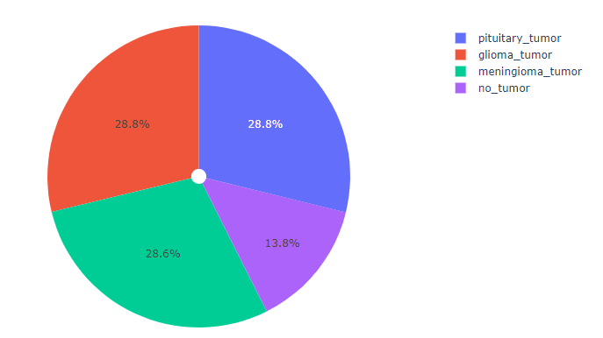
Classes info

Slide 10

CNN Models
26

Slide 11
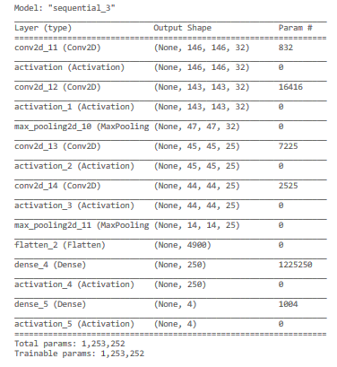
1st CNN model
The 1st model isn’t deep enough to give high accuracy and it was trained with number of epochs equal 5.
This model has training accuracy of 88% and testing accuracy of 81%.
It has 4 convolution layers and 2 max-pool layers.
29

Slide 12
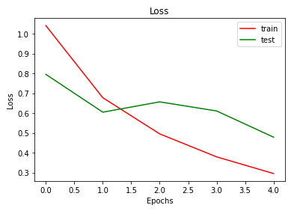
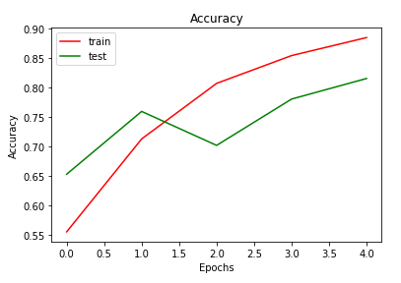
1st model evaluation
Loss function
Accuracy
The architecture of the model need to be deeper and we also need to train the model on a higher number of epochs.
34

Slide 13
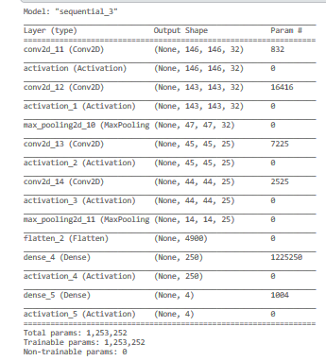
2nd CNN model
The 2nd model is deeper than the 1st one with 10 epochs.
This model has training accuracy of 86% and testing accuracy of 85%.
The model has 4 convolution layers, 2 max pool layers and the dropout technique was used.
We can notice that the difference between the training accuracy and the testing accuracy is less than the first model.
31

Slide 14
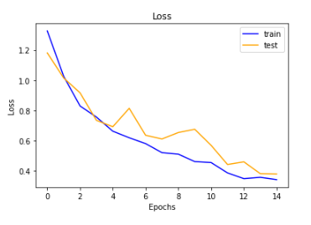
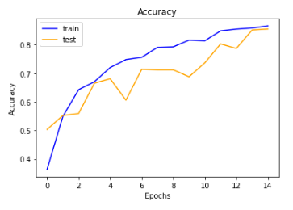
2nd model evaluation
Loss function
Accuracy
These results are better than the results of the 1st model but we still need higher number of epochs and deeper architecture.
34

Slide 15
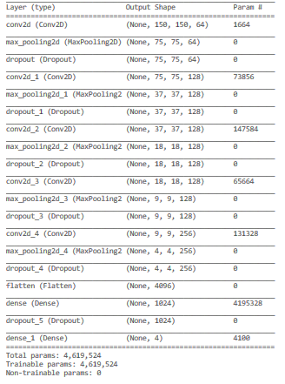
3rd CNN model
The 3rd model is the deepest one – with 50 epochs - as it has more convolution layers and deeper dense layer. We have also applied the dropout technique to overcome the overfitting problem.
The model has 5 convolution layers and 5 max pool layers.
The model has training accuracy of 97% and testing accuracy of 94%.
33

Slide 16
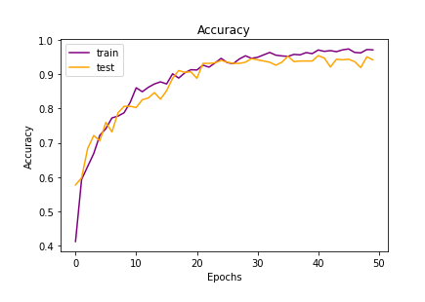
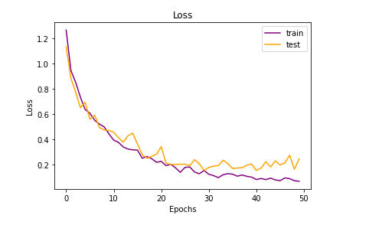
3rd model evaluation
Loss function
Accuracy
We can notice that the loss function decreases and the accuracy increases each epoch which means that the model keeps learning each epoch.
34

Slide 17
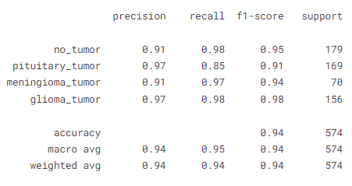
Classification report
1
Training accuracy
94%
0.799
97%
2
Testing Accuracy
35

Slide 18
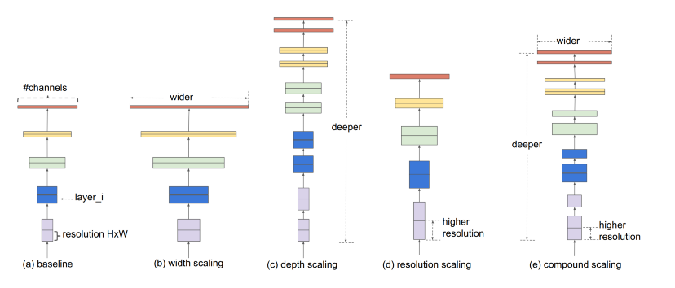
EfficientNet pretrained model
EfficientNet architecture
33

Slide 19
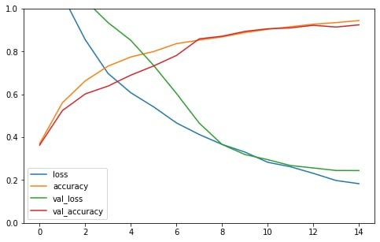
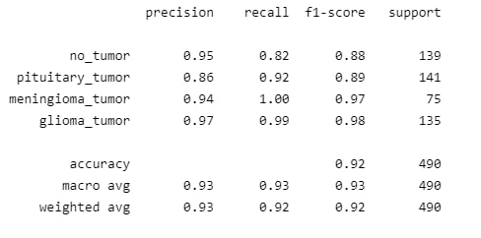
EfficientNet evaluation
Loss function and accuracy
Classification report
The model has training accuracy of 94% and testing accuracy of 92%
34

Slide 20
Project Deployment
47

Slide 21
The business solution here is to provide a user-friendly web application. So, instead of paying a visit to a doctor, the end user can know whether he/she having a tumor or no.

Slide 22
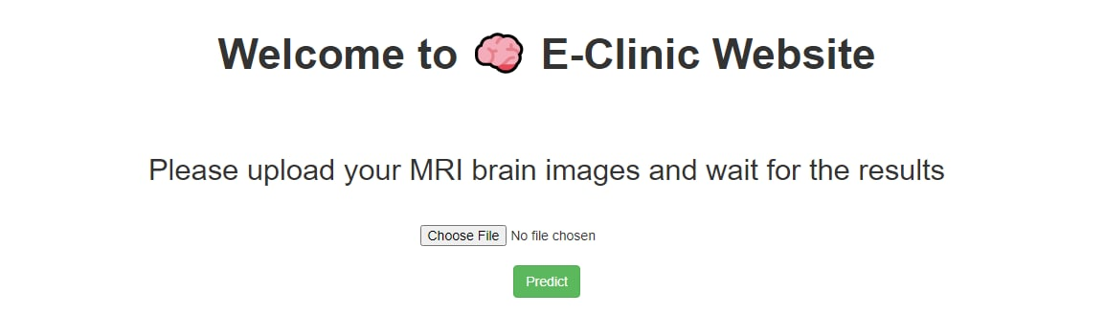
Application welcome page
33

Slide 23
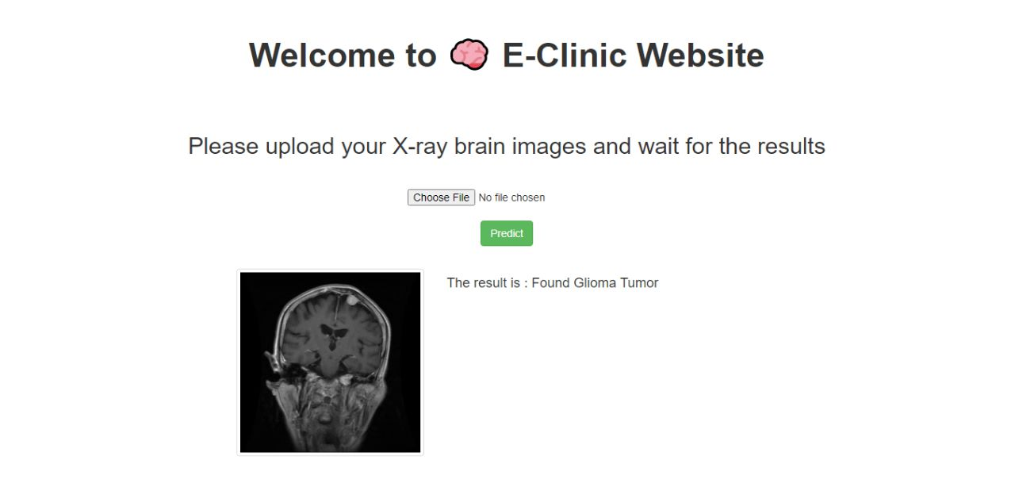
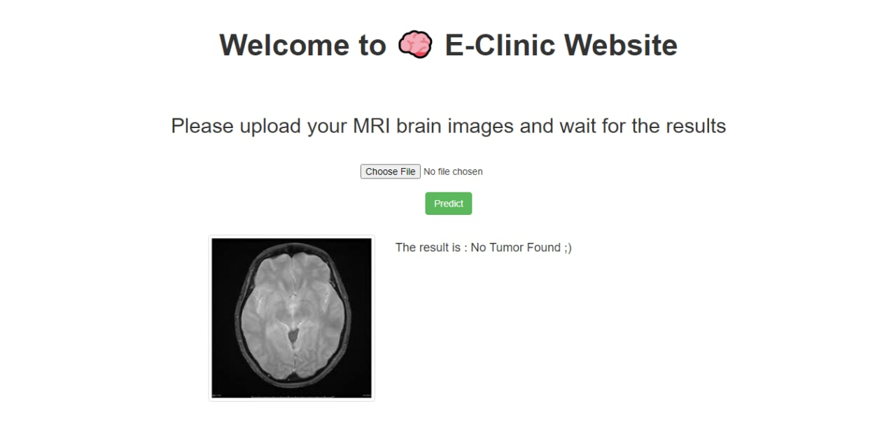
Using the application to know the result of the MRI
33

Slide 24




Thanks!
Please, feel free to contact us for any further information.
Muhammad Deep
Noura Medhat

